Slide 1
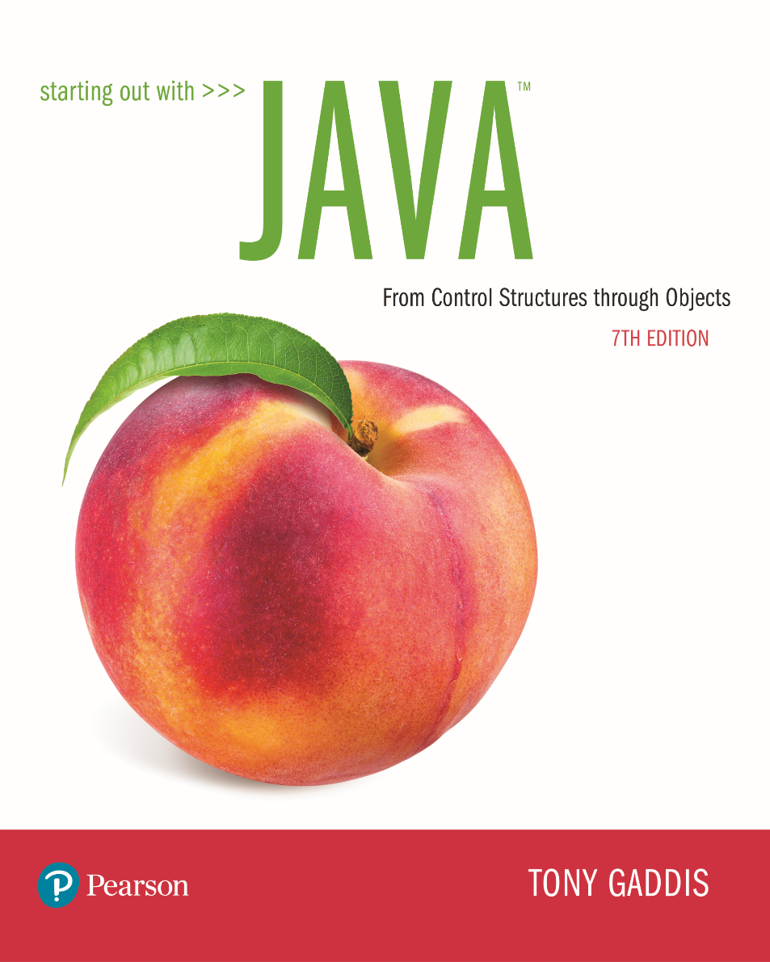

Slide 2
Examples’ Source Code
Source Code for examples presented in these slides can be found on:
Blackboard->Course Content->Source Code Of The Book Examples

Slide 3
Module Topics
Module 11 discusses the following main topics:
4.10 Introduction to File Input and Output
Writing Data to a File - PrintWriter class
Reading Data from a file – Scanner class
11.1 Handling Exceptions
11.2 Throwing Exceptions
Dialog boxes
FileChooser

Slide 4
File Input and Output
Reentering data all the time could get tedious for the user.
The data can be saved to a file.
Files can be input files or output files.
Files:
Files have to be opened.
Data is then written to or read from the file.
The file must be closed prior to program termination.
In general, there are two types of files:
binary
text

Slide 5
Writing Text To a File
PrintWriter outputFile = new PrintWriter("StudentData.txt");
Pass the name of the file that you wish to open as an argument to the PrintWriter constructor.
Warning: if the file already exists, it will be overwritten.
To open a file for text output you create an instance of the PrintWriter class.

Slide 6
The PrintWriter Class
The PrintWriter class allows you to write data to a file using the print and println methods, as you have been using to display data on the screen.
Just as with the System.out object, the println method of the PrintWriter class will place a newline character after the written data.
The print method writes data without writing the newline character.

Slide 7
The PrintWriter Class
Open the file.
PrintWriter outputFile = new PrintWriter("Names.txt");
outputFile.println("Chris");
outputFile.println("Kathryn");
outputFile.println("Jean");
outputFile.close();
Close the file.
Write data to the file.

Slide 8
The PrintWriter Class
To use the PrintWriter class, put the following import statement at the top of the source file: import java.io.*;
See example: FileWriteDemo.java

Slide 9
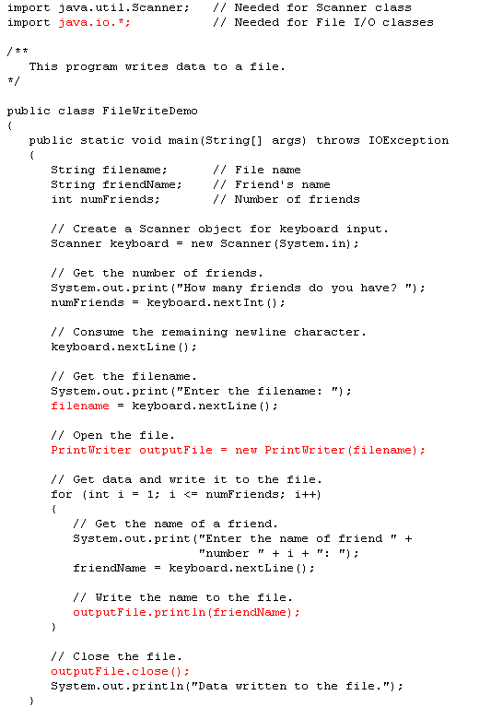

Slide 10
Exceptions
When something unexpected happens in a Java program, an exception is thrown.
The method that is executing when the exception is thrown must either handle the exception or pass it back to the calling method.

Slide 11
Exceptions
Handling the exception will be discussed later.
To pass it back to the calling method, the method needs a throws clause in the method header.

Slide 12
Throwing an Exception
To insert a throws clause in a method header, simply add the word throws and the name of the expected exception.
PrintWriter objects can throw an IOException, so we must write the throws clause like this:
public static void main(String[] args) throws IOException

Slide 13
Throwing an Exception example code
public static void main(String[] args) throws IOExecption
{
File file; // For file input
Scanner inputFile; // For file input
String fileName; // To hold a file name
// Get a file name from the user.
fileName = JOptionPane.showInputDialog("Enter " +
"the name of a file:");
// Attempt to open the file.
file = new File(fileName);
inputFile = new Scanner(file);
. . .
. . .
}

Slide 14
Handling Exceptions (1 of 2)
An exception is an object that is generated as the result of an error or an unexpected event.
Exception are said to have been “thrown.”
It is the programmers responsibility to write code that detects and handles exceptions.
Unhandled exceptions will crash a program.
Example: BadArray.java
Java allows you to create exception handlers.

Slide 15
Handling Exceptions (2 of 2)
An exception handler is a section of code that gracefully responds to exceptions.
The process of intercepting and responding to exceptions is called exception handling.
The default exception handler deals with unhandled exceptions.
The default exception handler prints an error message and crashes the program.

Slide 16
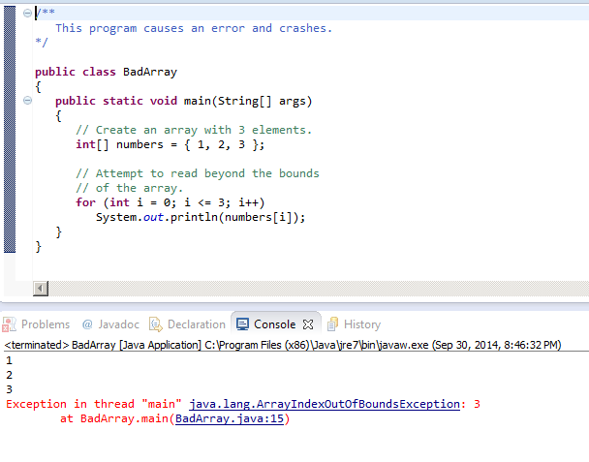
Code Example that generates an Exception
default exception handler

Slide 17
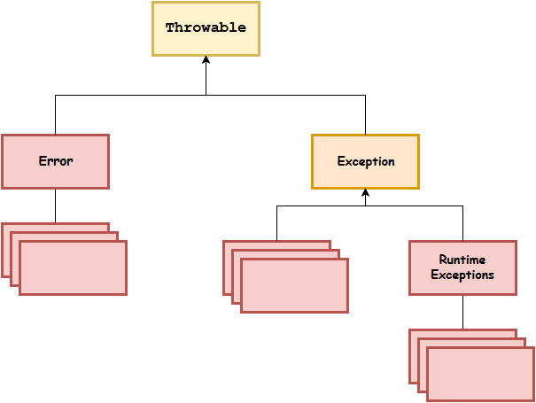
Exception Classes (1 of 3)
An exception is an object.
Exception objects are created
from classes in the Java API hierarchy of
exception classes.
All of the exception classes in the hierarchy are derived from the Throwable class.
Error and Exception are derived from the Throwable class.

Slide 18
Exception Classes (2 of 3)
Classes that are derived from Error:
are for exceptions that are thrown
when critical errors occur (i.e.):
an internal error in the Java Virtual Machine, or
running out of memory.
Applications should not try to handle these errors because they are the result of a serious condition.
Programmers should handle the exceptions that are instances of classes that are derived from the Exception class.

Slide 19
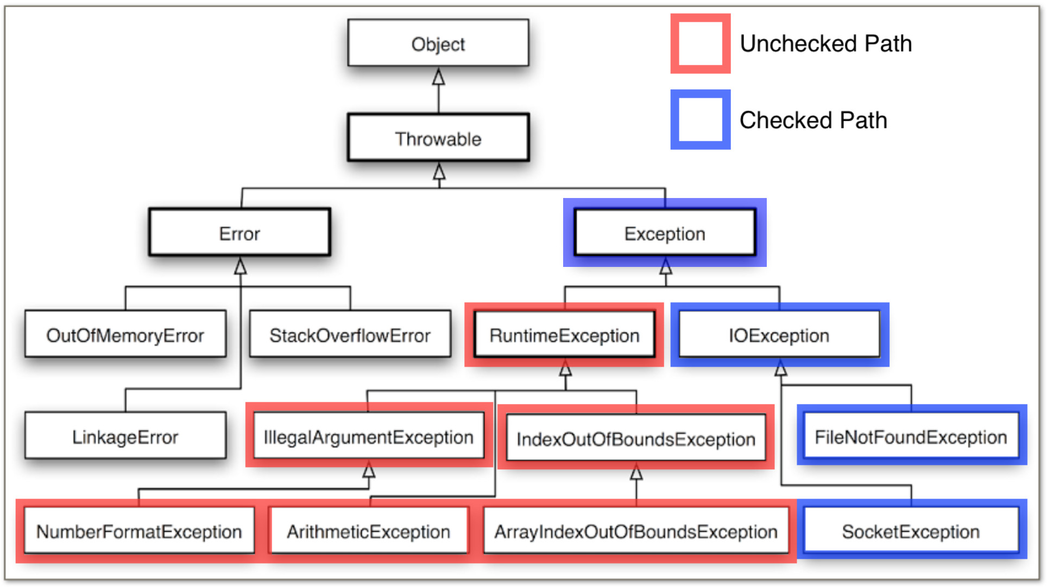
Exception Classes Hierarchy (3 of 3)

Slide 20
Handling Exceptions (1 of 6)
To handle an exception, you use a try statement.
try
{
(try block statements...)
}
catch (ExceptionType ParameterName)
{
(catch block statements...)
}
First the keyword try indicates a block of code will be attempted (the curly braces are required).
This block of code is known as a try block.

Slide 21
Handling Exceptions (2 of 6)
A try block is:
one or more statements that are executed, and
can potentially throw an exception.
The application will not halt if the try block throws an exception.
After the try block, a catch clause appears.

Slide 22
Handling Exceptions (3 of 6)
A catch clause begins with the key word catch:
catch (ExceptionType ParameterName)
ExceptionType is the name of an exception class and
ParameterName is a variable name which will reference the exception object if the code in the try block throws an exception.
The code that immediately follows the catch clause is known as a catch block (the curly braces are required).
The code in the catch block is executed if the try block throws an exception.

Slide 23
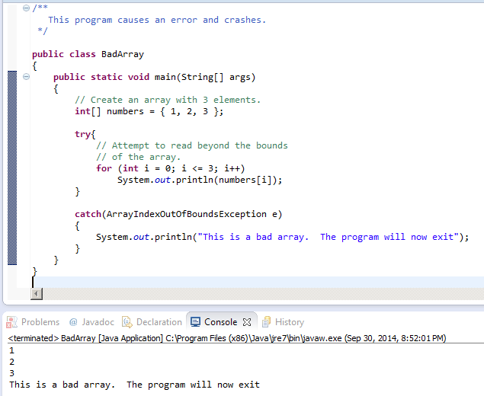
Handling Exceptions Code Example

Slide 24
Handling Exceptions (4 of 6)
This code is designed to handle a FileNotFoundException if it is thrown.
try
{
File file = new File ("MyFile.txt");
Scanner inputFile = new Scanner(file);
}
catch (FileNotFoundException e)
{
System.out.println("File not found.");
}
The Java Virtual Machine searches for a catch clause that can deal with the exception.
Example: OpenFile.java

Slide 25
Handling Exceptions (5 of 6)
The parameter must be of a type that is compatible with the thrown exception’s type.
After an exception, the program will continue execution at the point just past the catch block.

Slide 26
Handling Exceptions (6 of 6)
Each exception object has a method named getMessage that can be used to retrieve the default error message for the exception.
Example:
ExceptionMessage.java
ParseIntError.java

Slide 27
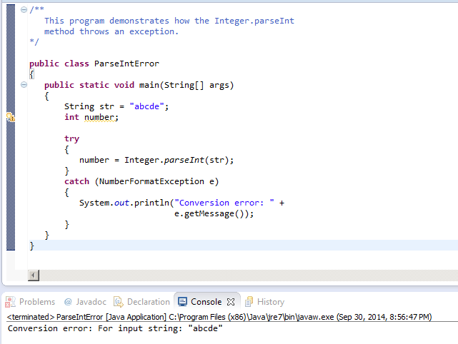
Code Example using getMessage() method

Slide 28
Polymorphic References To Exceptions (1 of 2)
When handling exceptions, you can use a polymorphic reference as a parameter in the catch clause.
Most exceptions are derived from the Exception class.
A catch clause that uses a parameter variable of the Exception type is capable of catching any exception that is derived from the Exception class.

Slide 29
Polymorphic References To Exceptions (2 of 2)
try
{
number = Integer.parseInt(str);
}
catch (Exception e)
{
System.out.println("The following error occurred: " + e.getMessage());
}
The Integer class’s parseInt method throws a NumberFormatException object.
The NumberFormatException class is derived from the Exception class.

Slide 30
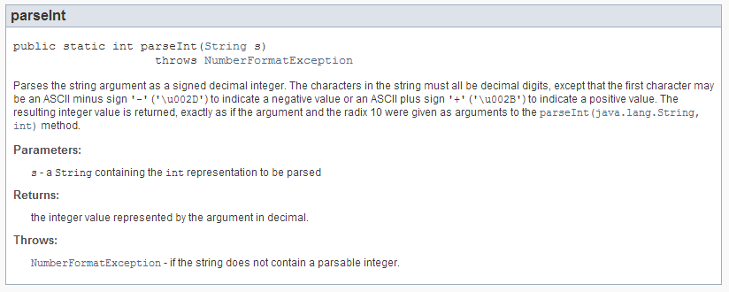
Exception Handlers
How do I know what Exceptions a particular method might throw?
try
{
number = Integer.parseInt(str);
}

Slide 31
Handling Multiple Exceptions
The code in the try block may be capable of throwing more than one type of exception.
A catch clause needs to be written for each type of exception that could potentially be thrown.
The JVM will run the first compatible catch clause found.
The catch clauses must be listed from most specific to most general.
Example: SalesReport.java, SalesReport2.java

Slide 32
Exception Handlers (1 of 3)
There can be many polymorphic catch clauses.
A try statement may have only one catch clause for each specific type of exception.
try
{
number = Integer.parseInt(str);
}
catch (NumberFormatException e)
{
System.out.println("Bad number format.");
}
catch (NumberFormatException e) // ERROR!!!
{
System.out.println(str + " is not a number.");
}
Same exceptions

Slide 33
Exception Handlers (2 of 3)
The NumberFormatException class is derived from the IllegalArgumentException class.
try
{
number = Integer.parseInt(str);
}
catch (IllegalArgumentException e)
{
System.out.println("Bad number format.");
}
catch (NumberFormatException e) // ERROR!!!
{
System.out.println(str + " is not a number.");
}
Sub class should be caught first

Slide 34
Exception Handlers (3 of 3)
The previous code could be rewritten to work, as follows, with no errors:
try
{
number = Integer.parseInt(str);
}
catch (NumberFormatException e)
{
System.out.println(str + " is not a number.");
}
catch (IllegalArgumentException e) //OK
{
System.out.println("Bad number format.");
}

Slide 35
The finally Clause (1 of 3)
The try statement may have an optional finally clause.
If present, the finally clause must appear after all of the catch clauses.
try
{
< Code that might throw an exception, either by executing a throw statement or by calling a method that throws an exception >
}
catch (AnException e)
{
< Code that handles exceptions of type AnException or a subclass of AnException >
}
< Possibly other catch blocks to handle other types of exceptions >
finally
{
< Code that executes after either the try block or an executing catch block ends >
}

Slide 36
The finally Clause (2 of 3)
The finally block is one or more statements,
that are always executed after the try block has executed and
after any catch blocks have executed if an exception was thrown.
The statements in the finally block execute whether an exception occurs or not.

Slide 37
The finally Clause (3 of 3)
try
{
openRefrigerator();
takeOutMilk();
pourMilk();
putBackMilk();
}
catch (NoMilkException e)
{
System.out.println(e.getMessage());
}
finally
{
closeRefrigerator();
}
Whether an exception occurs or not, closeRefrigerator is called within the finally block.

Slide 38
The Stack Trace
The call stack is an internal list of all the methods that are currently executing.
A stack trace is a list of all the methods in the call stack.
It indicates:
the method that was executing when an exception occurred and
all of the methods that were called in order to execute that method.
Example: StackTrace.java

Slide 39
Uncaught Exceptions (1 of 2)
When an exception is thrown, it cannot be ignored.
It must be handled by the program, or by the default exception handler.
When the code in a method throws an exception:
normal execution of that method stops, and
the JVM searches for a compatible exception handler inside the method.

Slide 40
Uncaught Exceptions (2 of 2)
If there is no exception handler inside the method:
control of the program is passed to the previous method in the call stack.
If that method has no exception handler, then control is passed again, up the call stack, to the previous method.
If control reaches the main method:
the main method must either handle the exception, or
the program is halted and the default exception handler handles the exception.

Slide 41
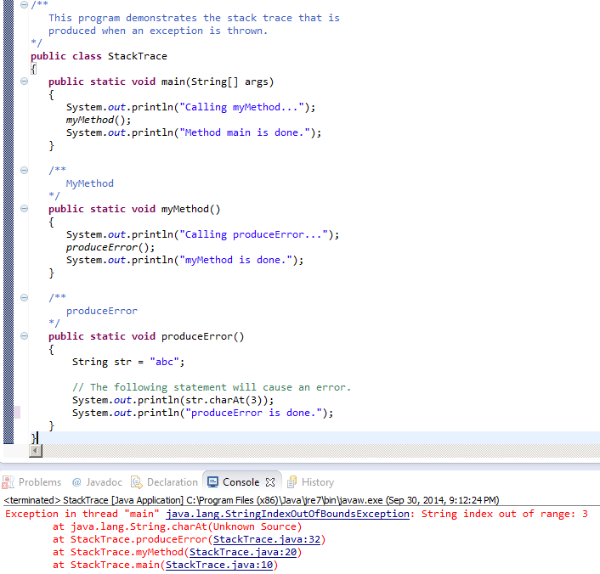
Error occurs here
Method calling produceError
Method calling myMethod

Slide 42
Multi-Catch (Java 7)
Beginning in Java 7, you can specify more than one exception in a catch clause:
try
{
}
catch(NumberFormatException | InputMismatchException ex)
{
}
Separate the exceptions with
the | character.

Slide 43
Checked and Unchecked Exceptions (1 of 5)
There are two categories of exceptions:
unchecked
checked.
Unchecked exceptions are those that are derived from the Error class or the RuntimeException class.
Exceptions derived from Error are thrown when a critical error occurs, and should not be handled.
RuntimeException serves as a superclass for exceptions that result from programming errors.

Slide 44
Exception Classes (3 of 3)

Slide 45
Checked and Unchecked Exceptions (1 of 5)
There are two categories of exceptions:
unchecked
checked.
Unchecked exceptions are those that are derived from the Error class or the RuntimeException class.
Exceptions derived from Error are thrown when a critical error occurs, and should not be handled.
RuntimeException serves as a superclass for exceptions that result from programming errors.

Slide 46
Checked and Unchecked Exceptions (2 of 5)
These exceptions can be avoided with properly written code.
Unchecked exceptions, in most cases, should not be handled.
All exceptions that are not derived from Error or RuntimeException are checked exceptions.

Slide 47
Checked and Unchecked Exceptions (3 of 5)
If the code in a method can throw a checked exception, the method:
must handle the exception, or
it must have a throws clause listed in the method header.
The throws clause informs the compiler what exceptions can be thrown from a method.

Slide 48
Checked and Unchecked Exceptions (4 of 5)
// This method will not compile!
public void displayFile(String name)
{
// Open the file.
File file = new File(name);
Scanner inputFile = new Scanner(file);
// Read and display the file's contents.
while (inputFile.hasNext())
{
System.out.println(inputFile.nextLine());
}
// Close the file.
inputFile.close();
}

Slide 49
Checked and Unchecked Exceptions (5 of 5)
The code in this method is capable of throwing checked exceptions.
The keyword throws can be written at the end of the method header, followed by a list of the types of exceptions that the method can throw.
public void displayFile(String name) throws FileNotFoundException

Slide 50
Throwing Exceptions (1 of 2)
You can write code that:
throws one of the standard Java exceptions, or
an instance of a custom exception class that you have designed.
The throw statement is used to manually throw an exception.
throw new ExceptionType(MessageString);
The throw statement causes an exception object to be created and thrown.

Slide 51
Throwing Exceptions (2 of 2)
The MessageString argument contains a custom error message that can be retrieved from the exception object’s getMessage method.
If you do not pass a message to the constructor, the exception will have a null message.
throw new Exception("Out of fuel");
Note: Don’t confuse the throw statement with the throws clause.
Example: DieExceptionDemo.java

Slide 52
Creating Exception Classes (1 of 2)
You can create your own exception classes by deriving them from the Exception class or one of its derived classes.
Example:
BankAccount.java
NegativeStartingBalance.java
AccountTest.java

Slide 53
Code Example of Creating Custom Exception Class
public class NegativeStartingBalance extends Exception
{
/**
This constructor uses a generic
error message.
*/
public NegativeStartingBalance()
{
super("Error: Negative starting balance");
}
/**
This constructor specifies the bad starting
balance in the error message.
@param The bad starting balance.
*/
public NegativeStartingBalance(double amount)
{
super("Error: Negative starting balance: " +
amount);
}
}
Calls Exception Class constructor

Slide 54
Creating Exception Classes (2 of 2)
Some examples of exceptions that can affect a bank account:
A negative starting balance is passed to the constructor.
A negative interest rate is passed to the constructor.
A negative number is passed to the deposit method.
A negative number is passed to the withdraw method.
The amount passed to the withdraw method exceeds the account’s balance.
We can create exceptions that represent each of these error conditions.

Slide 55
@exception Tag in Documentation Comments
General format
@exception ExceptionName Description
The following rules apply
The @exception tag in a method’s documentation comment must appear after the general description of the method.
The description can span several lines. It ends at the end of the documentation comment (the */ symbol) or at the beginning of another tag.

Slide 56
Exception Handling Keywords Summary
throw – When any exception occurs, an exception object is getting created and then Java runtime starts processing to handle them. Sometime we might want to generate exception explicitly in our code, for example in a user authentication program we should throw exception to client if the password is null. throw keyword is used to throw exception to the runtime to handle it.
throws – When we are throwing any exception in a method and not handling it, then we need to use throws keyword in method signature to let caller program know the exceptions that might be thrown by the method. The caller method might handle these exceptions or propagate it to it’s caller method using throws keyword. We can provide multiple exceptions in the throws clause and it can be used with main() method also.

Slide 57
Exception Handling Keywords Summary
try-catch – We use try-catch block for exception handling in our code. try is the start of the block and catch is at the end of try block to handle the exceptions. We can have multiple catch blocks with a try and try-catch block can be nested also. catch block requires a parameter that should be of type Exception.
finally – finally block is optional and can be used only with try-catch block. Since exception halts the process of execution, we might have some resources open that will not get closed, so we can use finally block. finally block gets executed always, whether exception occurred or not.

Slide 58
Reading Data From a File
You use the File class and the Scanner class to read data from a file:
Pass the name of the file as an argument to the File class constructor.
File myFile = new File("Customers.txt");
Scanner inputFile = new Scanner(myFile);
Pass the File object as an argument to the Scanner class constructor.

Slide 59
Reading Data From a File
Scanner keyboard = new Scanner(System.in);
System.out.print("Enter the filename: ");
String filename = keyboard.nextLine();
File file = new File(filename);
Scanner inputFile = new Scanner(file);
The lines above:
Creates an instance of the Scanner class to read from the keyboard
Prompt the user for a filename
Get the filename from the user
Create an instance of the File class to represent the file
Create an instance of the Scanner class that reads from the file

Slide 60
Reading Data From a File
Once an instance of Scanner is created, data can be read using the same methods that you have used to read keyboard input (nextLine, nextInt, nextDouble, etc).
// Open the file.
File file = new File("Names.txt");
Scanner inputFile = new Scanner(file);
// Read a line from the file.
String str = inputFile.nextLine();
// Close the file.
inputFile.close();

Slide 61
Exceptions
The Scanner class can throw an IOException when a File object is passed to its constructor.
So, we put a throws IOException clause in the header of the method that instantiates the Scanner class.

Slide 62
Detecting The End of a File
The Scanner class’s hasNext() method will return true if another item can be read from the file.
// Open the file.
File file = new File(filename);
Scanner inputFile = new Scanner(file);
// Read until the end of the file.
while (inputFile.hasNext())
{
String str = inputFile.nextLine();
System.out.println(str);
}
inputFile.close();// close the file when done.

Slide 63
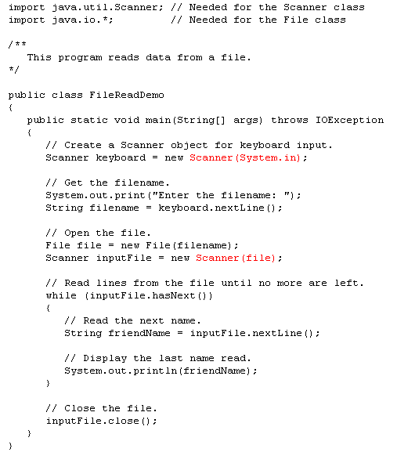

Slide 64
Appending Text to a File
This means that you want to append to the end of the file
To avoid erasing a file that already exists, create a FileWriter object in this manner: FileWriter fw = new FileWriter("names.txt", true);
Then, create a PrintWriter object in this manner: PrintWriter pw = new PrintWriter(fw);

Slide 65
Specifying a File Location
On a Windows computer, paths contain backslash (\) characters.
Remember, if the backslash is used in a string literal, it is the escape character so you must use two of them:
PrintWriter outFile =
new PrintWriter("A:\\PriceList.txt");

Slide 66
Specifying a File Location
This is only necessary if the backslash is in a string literal.
If the backslash is in a String object then it will be handled properly.
Fortunately, Java allows Unix style filenames using the forward slash (/) to separate directories:
PrintWriter outFile = new
PrintWriter("/home/rharrison/names.txt");

Slide 67
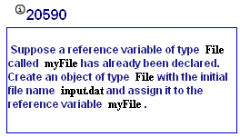
My Programming Lab 3 – 4.10 Files & output

Slide 68
Dialog Boxes
FileChooser

Slide 69
Dialog Boxes
Recall that a dialog box is a small window that "pops up" to interact with the user for a brief, specific purpose
The Alert and Dialog classes makes it easy to create dialog boxes for presenting information, confirming an action, or accepting an input value
Let's now look at another class that lets us create a specialized dialog box

Slide 70
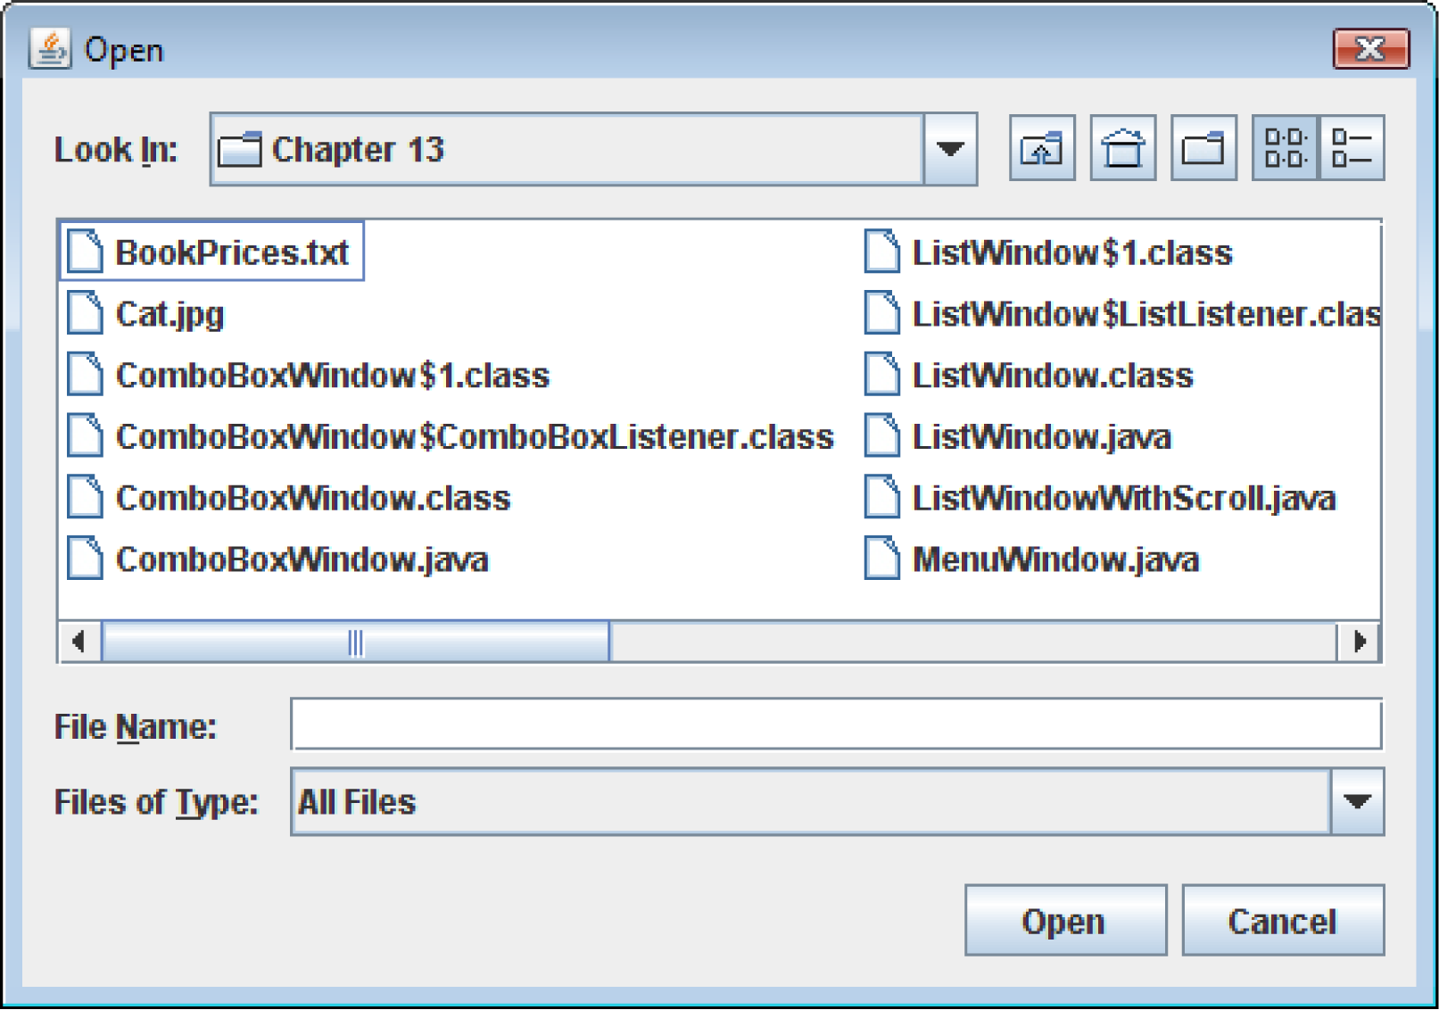
File Choosers
A file chooser is a specialized dialog box that allows the user to browse for a file and select it.

Slide 71
File Choosers
Situations often arise where we want the user to select a file stored on a disk drive, usually so that its contents can be read and processed
A file chooser, represented by the FileChooser class, simplifies this process
The user can browse the disk and filter the file types displayed

Slide 72
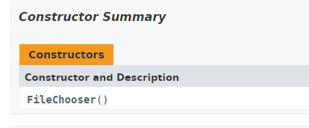
File Choosers
Create an instance of the FileChooser class to display a file chooser dialog box.
The constructors has the form:
FileChooser()
The constructor shown takes no arguments and uses the default directory as the starting point for all of its dialog boxes.

Slide 73
File Choosers
A FileChooser object can display two types of predefined dialog boxes:
open file dialog box – lets the user browse for an existing file to open.
a save file dialog box – lest the user browse to a location to save a file.

Slide 74
File Choosers
To display an open file dialog box, use the showOpenDialog method.
General format:
File showOpenDialog(Window parent)
The argument can be null or a reference to a window.
If null is passed, the dialog box is normally centered in the screen.
If you pass a reference to a window the dialog box is displayed over the window.

Slide 75
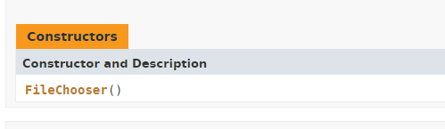
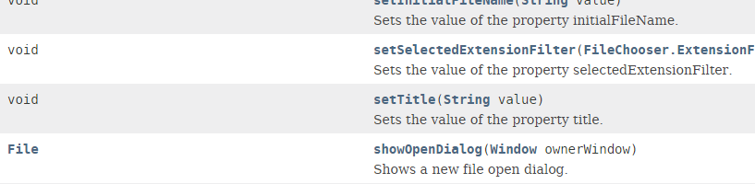
File Choosers
FileChooser chooser = new FileChooser();
File selectedFile = chooser.showOpenDialog(null);
if(selectedFile != null)
{
Scanner scan = new Scanner(selectedFile);

Slide 76
File Choosers
Use the File object’s getPath method to get the path and file name as a String.
FileChooser fileChooser = new FileChooser();
File selectedFile = fileChooser.showOpenDialog(null);
File selectedFile =
fileChooser.getSelectedFile();
String filename = selectedFile.getPath();
JOptionPane.showMessageDialog(null,
"You selected " + filename);
}

Slide 77
File Choosers
To display a save file dialog box, use the showSaveDialog method.
General format:
File showSaveDialog(Window parent)
The argument can be either null or a reference to a window.
Both methods return a File that indicates the file selected by the user.

Slide 78
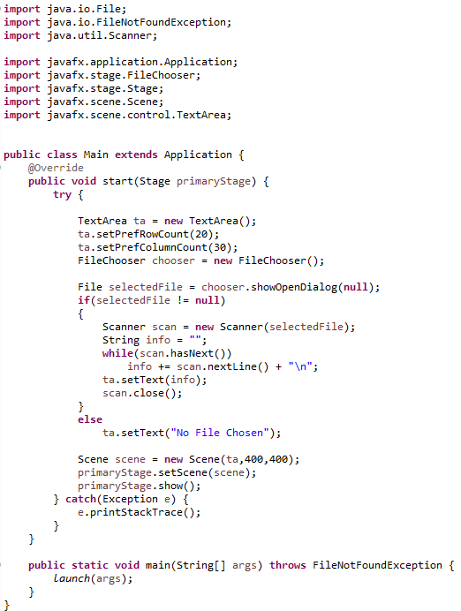
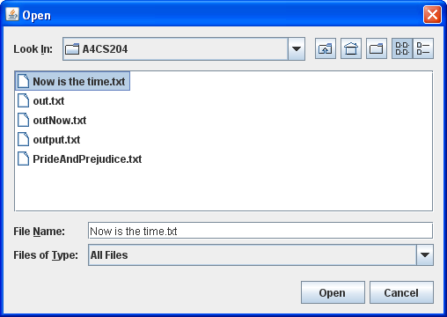
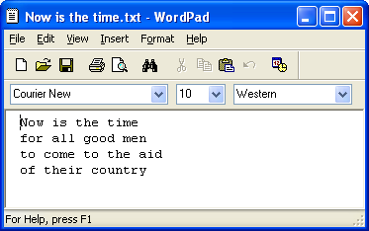
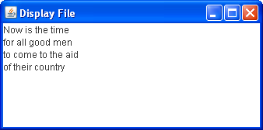

Slide 79
FileChooser and File I/0
(the rest of the story)

Slide 80
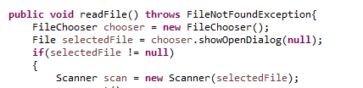
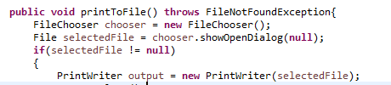
When you need to read from a file or write to a file, it is a good idea to use
the FileChooser so that the user can select the file name, instead of typing
in the file name and causing possible errors. You must include the throws
clause in the method header.

Slide 81
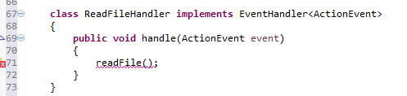
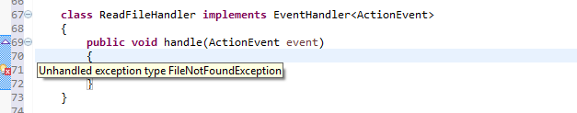
The problem comes when the you try to call these methods from the handle
method of a class that implements EventHandler.
The error shows that there is an unhandled exception type

Slide 82
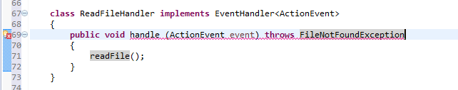
Being the smart resourceful programmer that you are, you remember that you need
to include the throws clause in the method header, so you try that:
But, the signature/header of the handle method cannot be changed.
Therefore it will not allow the throws clause to be attached to the
handle method header.

Slide 83
To solve the problem, do the following:
Do not put the throws clause in the handle method header
But you are still left with that pesky error:

Slide 84
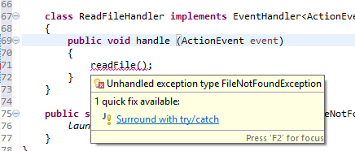
Run your mouse over the red underlined method call. There is a popup
that gives suggestions on how to solve the problem (quick fix).
3. Click on the Surround with try/catch

Slide 85
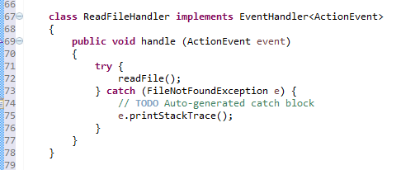
The following code will be automatically placed in your method.

